Slide 1
HIBERNATE
Prepared By:Prof Shital Pathar

Slide 2
OVERVIEW
Hibernate is a high-performance Object/Relational persistence and query service which is licensed under the open source GNU Lesser General Public License (LGPL) and is free to download.
Hibernate not only takes care of the mapping from Java classes to database tables (and from Java data types to SQL data types), but also provides data query and retrieval facilities.

Slide 3
What is JDBC?
JDBC stands for Java Database Connectivity and provides a set of Java API for accessing the relational databases from Java program. These Java APIs enables Java programs to execute SQL statements and interact with any SQL compliant database.
JDBC provides a flexible architecture to write a database independent application that can run on different platforms and interact with different DBMS without any modification.

Slide 4
Pros and Cons of JDBC
Clean and simple SQL processing
Good performance with large data
Very good for small applications
Simple syntax so easy to learn
Complex if it is used in large projects
Large programming overhead
No encapsulation
Hard to implement MVC concept
Query is DBMS specific

Slide 5
Why Object Relational Mapping (ORM)?
When we work with an object-oriented systems, there's a mismatch between the object model and the relational database. RDBMSs represent data in a tabular format whereas object-oriented languages, such as Java or C# represent it as an interconnected graph of objects.

Slide 6
JAVA PROGRAM
public class Employee
{ private int id;
private String first_name;
private String last_name;
private int salary;
public Employee() {}
public Employee(String fname, String lname, int salary) {
this.first_name = fname; this.last_name = lname; this.salary = salary; }
public int getId()
{ return id; }
public String getFirstName()
{ return first_name; }
public String getLastName()
{ return last_name; }
public int getSalary()
{ return salary; }
}

Slide 7
RDBMS table:
create table EMPLOYEE (
id INT NOT NULL auto_increment,
first_name VARCHAR(20) default NULL, last_name VARCHAR(20) default NULL,
salary INT default NULL, PRIMARY KEY (id) );

Slide 8
Problem
what if we need to modify the design of our database after having developed few pages or our application?
Loading and storing objects in a relational database exposes us to the following five mismatch problems.

Slide 9
Mismatch
Mismatch | Description
Granularity | Sometimes you will have an object model which has more classes than the number of corresponding tables in the database.
Inheritance | RDBMSs do not define anything similar to Inheritance which is a natural paradigm in object-oriented programming languages.
Identity | A RDBMS defines exactly one notion of 'sameness': the primary key. Java, however, defines both object identity (a==b) and object equality (a.equals(b)).
Associations | Object-oriented languages represent associations using object references where as am RDBMS represents an association as a foreign key column.
Navigation | The ways you access objects in Java and in a RDBMS are fundamentally different.

Slide 10
What is ORM?
The Object-Relational Mapping (ORM) is the solution to handle all the above impedance mismatches.
ORM stands for Object-Relational Mapping (ORM) is a programming technique for converting data between relational databases and object oriented programming languages such as Java, C# etc.

Slide 11
ADVANTAGES OF ORM
Let’s business code access objects rather than DB tables.
Hides details of SQL queries from OO logic.
Based on JDBC 'under the hood‘
No need to deal with the database implementation.
Entities based on business concepts rather than database structure.
Transaction management and automatic key generation.
Fast development of application.

Slide 12
ORM solution
An API to perform basic CRUD operations on objects of persistent classes.
A language or API to specify queries that refer to classes and properties of classes.
A configurable facility for specifying mapping metadata.
A technique to interact with transactional objects to perform dirty checking, lazy association fetching, and other optimization functions.

Slide 13
Java ORM Frameworks:
Enterprise JavaBeans Entity Beans
Java Data Objects
Castor
TopLink
Spring DAO
Hibernate
And many more

Slide 14
Why Hibernate and not JDBC?
JDBC maps Java classes to database tables (and from Java data types to SQL data types)
Hibernate automatically generates the SQL queries.
Hibernate provides data query and retrieval facilities and can significantly reduce development time otherwise spent with manual data handling in SQL and JDBC.
Makes an application portable to all SQL databases.
These are some advantages of hibernate.

Slide 15
Hibernate vs. JDBC (an example)
JDBC tuple insertion –
st.executeUpdate(“INSERT INTO book VALUES(“Harry Potter”,”J.K.Rowling”));
Hibernate tuple insertion –
session.save(book1);

Slide 16
Hibernate - Overview
Hibernate is an Object-Relational Mapping(ORM) solution for JAVA and it raised as an open source persistent framework created by Gavin King in 2001. It is a powerful, high performance Object-Relational Persistence and Query service for any Java Application.
Hibernate maps Java classes to database tables and from Java data types to SQL data types and relieve the developer from 95% of common data persistence related programming tasks.

Slide 17
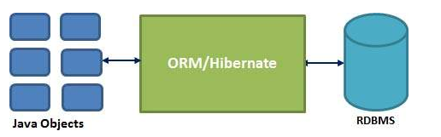
Hibernate sits between traditional Java objects and database server to handle all the work in persisting those objects based on the appropriate O/R mechanisms and patterns.

Slide 18
Hibernate Advantages:
Hibernate takes care of mapping Java classes to database tables using XML files and without writing any line of code.
Provides simple APIs for storing and retrieving Java objects directly to and from the database.
If there is change in Database or in any table then the only need to change XML file properties.
Abstract away the unfamiliar SQL types and provide us to work around familiar Java Objects.
Hibernate does not require an application server to operate.
Manipulates Complex associations of objects of your database.
Minimize database access with smart fetching strategies.
Provides Simple querying of data.

Slide 19
Supported Databases:
HSQL Database Engine
DB2/NT
MySQL
PostgreSQL
FrontBase
Oracle
Microsoft SQL Server Database
Sybase SQL Server
Informix Dynamic Server

Slide 20
Supported Technologies:
XDoclet Spring
J2EE
Eclipse plug-ins
Maven

Slide 21
Hibernate - Architecture
The Hibernate architecture is layered to keep you isolated from having to know the underlying APIs. Hibernate makes use of the database and configuration data to provide persistence services (and persistent objects) to the application.

Slide 22
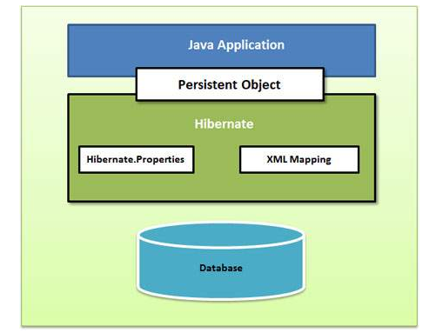

Slide 23
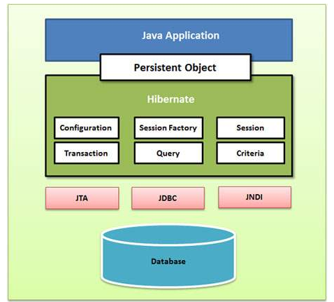
detailed view of the Hibernate Application Architecture

Slide 24
Hibernate uses various existing Java APIs, like JDBC, Java Transaction API(JTA), and Java Naming and Directory Interface (JNDI).
JDBC provides a rudimentary level of abstraction of functionality common to relational databases, allowing almost any database with a JDBC driver to be supported by Hibernate. JNDI and JTA allow Hibernate to be integrated with J2EE application servers.

Slide 25
Configuration Object:
The Configuration object is the first Hibernate object you create in any Hibernate application and usually created only once during application initialization. It represents a configuration or properties file required by the Hibernate. The Configuration object provides two keys components:
Database Connection: This is handled through one or more configuration files supported by Hibernate. These files are hibernate.properties and hibernate.cfg.xml.
Class Mapping Setup
This component creates the connection between the Java classes and database tables..

Slide 26
SessionFactory Object:
Configuration object is used to create a SessionFactory object which inturn configures Hibernate for the application using the supplied configuration file and allows for a Session object to be instantiated. The SessionFactory is a thread safe object and used by all the threads of an application.
The SessionFactory is heavyweight object so usually it is created during application start up and kept for later use. You would need one SessionFactory object per database using a separate configuration file. So if you are using multiple databases then you would have to create multiple SessionFactory objects.

Slide 27
Session Object:
A Session is used to get a physical connection with a database. The Session object is lightweight and designed to be instantiated each time an interaction is needed with the database. Persistent objects are saved and retrieved through a Session object.
The session objects should not be kept open for a long time because they are not usually thread safe and they should be created and destroyed them as needed.

Slide 28
Transaction Object:
A Transaction represents a unit of work with the database and most of the RDBMS supports transaction functionality. Transactions in Hibernate are handled by an underlying transaction manager and transaction (from JDBC or JTA).
This is an optional object and Hibernate applications may choose not to use this interface, instead managing transactions in their own application code.

Slide 29
Query Object:
Query objects use SQL or Hibernate Query Language (HQL) string to retrieve data from the database and create objects. A Query instance is used to bind query parameters, limit the number of results returned by the query, and finally to execute the query.

Slide 30
Criteria Object:
Criteria object are used to create and execute object oriented criteria queries to retrieve objects.

Slide 31
Hibernate - Mapping Types
When you prepare a Hibernate mapping document, we have seen that you map Java data types into RDBMS data types. The types declared and used in the mapping files are not Java data types; they are not SQL database types either. These types are called Hibernate mapping types, which can translate from Java to SQL data types and vice versa.

Slide 32
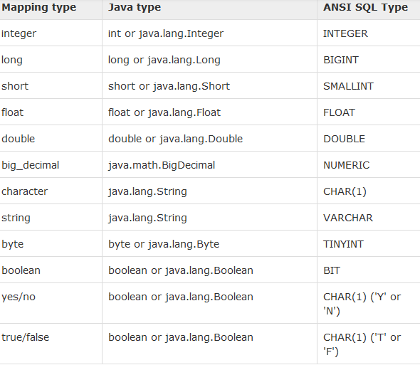
Primitive types:

Slide 33
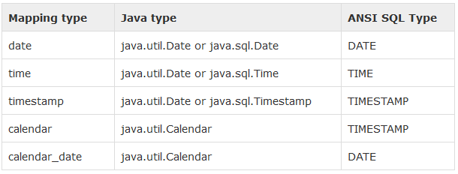
Date and time types:

Slide 34
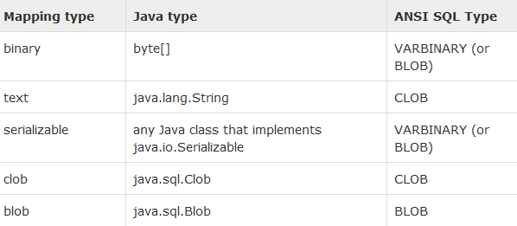
Binary and large object types:

Slide 35
JDK-related types:

Slide 36
Hibernate O/R Mapping
Collections Mappings
Association Mappings
Component Mappings

Slide 37
Collections Mappings:
If an entity or class has collection of values for a particular variable, then we can map those values using any one of the collection interfaces available in java. Hibernate can persist instances of
>java.util.Map
> java.util.Set
java.util.SortedMap
> java.util.SortedSet
> java.util.List,
any array of persistent entities or values.
If you want to map a user defined collection interfaces which is not directly supported by Hibernate, you need to tell Hibernate about the semantics of your custom collections which is not very easy and not recommend to be used.

Slide 38
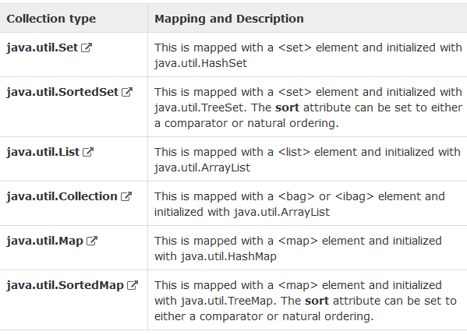

Slide 39
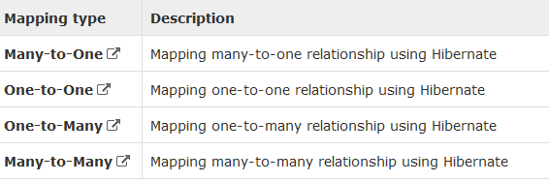
Association Mappings:
The mapping of associations between entity classes and the relationships between tables is the soul of ORM. Following are the four ways in which the cardinality of the relationship between the objects can be expressed. An association mapping can be unidirectional as well as bidirectional.

Slide 40

Component Mappings
It is very much possible that an Entity class can have a reference to another class as a member variable. If the referred class does not have it's own life cycle and completely depends on the life cycle of the owning entity class, then the referred class hence therefore is called as the Component class.
The mapping of Collection of Components is also possible in a similar way just as the mapping of regular Collections with minor configuration differences.

Slide 41
Hibernate - Annotations
Hibernate Annotations is the powerful way to provide the metadata for the Object and Relational Table mapping. All the metadata is clubbed into the POJO java file along with the code this helps the user to understand the table structure and POJO simultaneously during the development.
If you going to make your application portable to other EJB 3 compliant ORM applications, you must use annotations to represent the mapping information but still if you want greater flexibility then you should go with XML-based mappings.

Slide 42
Environment Setup for Hibernate Annotation
First of all you would have to make sure that you are using JDK 5.0 otherwise you need to upgrade your JDK to JDK 5.0 to take advantage of the native support for annotations.
Second, you will need to install the Hibernate 3.x annotations distribution package, available from the nd copy hibernate-annotations.jar, lib/hibernate-comons-annotations.jar and lib/ejb3-persistence.jar from the Hibernate Annotations distribution to your CLASSPATH

Slide 43
Various Annotations
@Entity Annotation:
@Table Annotation:
@Id and @GeneratedValue Annotations:
@Column Annotation:

Slide 44
@Entity
@org.hibernate.annotations.Entity(optimisticLock = OptimisticLockType.ALL)
@Table(name = "Employee", uniqueConstraints = {
@UniqueConstraint(columnNames = "ID"),
@UniqueConstraint(columnNames = "EMAIL") })
public class EmployeeEntity implements Serializable {
private static final long serialVersionUID = -1798070786993154676L;
@Id
@GeneratedValue(strategy = GenerationType.IDENTITY)
@Column(name = "ID", unique = true, nullable = false)
private Integer employeeId;
@Column(name = "EMAIL", unique = true, nullable = false, length = 100)
private String email;
@Column(name = "FIRST_NAME", unique = false, nullable = false, length = 100)
private String firstName;
@Column(name = "LAST_NAME", unique = false, nullable = false, length = 100)
private String lastName;
// Accessors and mutators for all four fields
}

Slide 45
@Entity Annotation:
We use the @Entity annotation to the particular class which marks that class as an entity bean.

Slide 46
@Table Annotation:
The @Table annotation allows you to specify the details of the table that will be used to persist the entity in the database.
The @Table annotation provides four attributes, allowing you to override the name of the table, its catalogue, and its schema, and enforce unique constraints on columns in the table.

Slide 47
@Id
Each entity bean will have a primary key, which you annotate on the class with the @Id annotation. The primary key can be a single field or a combination of multiple fields depending on your table structure.
By default, the @Id annotation will automatically determine the most appropriate primary key generation strategy to be used but you can override this by applying the @GeneratedValue annotation which takes two parameters strategy and generator which I'm not going to discuss here, so let us use only default the default key generation strategy. Letting Hibernate determine which generator type to use makes your code portable between different databases.

Slide 48
@Column Annotation:
The @Column annotation is used to specify the details of the column to which a field or property will be mapped. You can use column annotation with the following most commonly used attributes:
name attribute permits the name of the column to be explicitly specified.
length attribute permits the size of the column used to map a value particularly for a String value.
nullable attribute permits the column to be marked NOT NULL when the schema is generated.
unique attribute permits the column to be marked as containing only unique values.

Slide 49
Hibernate - Query Language
Hibernate Query Language (HQL) is an object-oriented query language, similar to SQL, but instead of operating on tables and columns, HQL works with persistent objects and their properties. HQL queries are translated by Hibernate into conventional SQL queries which in turns perform action on database.
Although you can use SQL statements directly with Hibernate using Native SQL but I would recommend to use HQL whenever possible to avoid database portability hassles, and to take advantage of Hibernate's SQL generation and caching strategies.
Keywords like SELECT , FROM and WHERE etc. are not case sensitive but properties like table and column names are case sensitive in HQL.

Slide 50
Advantages of HQL
The HQL can perform bulk of operations at a time on hibernate.
HQL supports object oriented features such as inheritance ,polymorphism,association and so on.
Instead of returning plain data HQL queries returns the objects .These objects can be easily accessed ,or programmed.
HQL is database independent.The same HQL can be executed on different databases whereas SQL is database dependent.

Slide 51
1.FROM Clause
You will use FROM clause if you want to load a complete persistent objects into memory. Following is the simple syntax of using FROM clause:
String hql = "FROM Employee";
Query query = session.createQuery(hql);
List results = query.list();

Slide 52
2.AS Clause
The AS clause can be used to assign aliases to the classes in your HQL queries, specially when you have long queries. For instance, our previous simple example would be the following:
String hql = "FROM Employee AS E";
Query query = session.createQuery(hql);
List results = query.list();

Slide 53
3.SELECT Clause
The SELECT clause provides more control over the result set than the from clause. If you want to obtain few properties of objects instead of the complete object, use the SELECT clause. Following is the simple syntax of using SELECT clause to get just first_name field of the Employee object:
String hql = "SELECT E.firstName FROM Employee E";
Query query = session.createQuery(hql);
List results = query.list();

Slide 54
4.WHERE Clause
If you want to narrow the specific objects that are returned from storage, you use the WHERE clause. Following is the simple syntax of using WHERE clause:
String hql = "FROM Employee E WHERE E.id = 10";
Query query = session.createQuery(hql);
List results = query.list();

Slide 55
5.ORDER BY Clause
To sort your HQL query's results, you will need to use the ORDER BY clause. You can order the results by any property on the objects in the result set either ascending (ASC) or descending (DESC). Following is the simple syntax of using ORDER BY clause:
String hql = "FROM Employee E WHERE E.id > 10 ORDER BY E.salary DESC";
Query query = session.createQuery(hql);
List results = query.list();
If you wanted to sort by more than one property, you would just add the additional properties to the end of the order by clause, separated by commas as follows:
String hql = "FROM Employee E WHERE E.id > 10 " + "ORDER BY E.firstName DESC, E.salary DESC ";
Query query = session.createQuery(hql);
List results = query.list();

Slide 56
6.GROUP BY Clause
This clause lets Hibernate pull information from the database and group it based on a value of an attribute and, typically, use the result to include an aggregate value. Following is the simple syntax of using GROUP BY clause:
String hql = "SELECT SUM(E.salary), E.firtName FROM Employee E " + "GROUP BY E.firstName";
Query query = session.createQuery(hql);
List results = query.list();

Slide 57
7.UPDATE Clause
Bulk updates are new to HQL with Hibernate 3, and deletes work differently in Hibernate 3 than they did in Hibernate 2. The Query interface now contains a method called executeUpdate() for executing HQL UPDATE or DELETE statements.
The UPDATE clause can be used to update one or more properties of an one or more objects. Following is the simple syntax of using UPDATE clause:
String hql = "UPDATE Employee set salary = :salary " + "WHERE id = :employee_id";
Query query = session.createQuery(hql);
query.setParameter("salary", 1000);
query.setParameter("employee_id", 10);
int result = query.executeUpdate();
System.out.println("Rows affected: " + result);

Slide 58
8.DELETE Clause
The DELETE clause can be used to delete one or more objects. Following is the simple syntax of using DELETE clause:
String hql = "DELETE FROM Employee " + "WHERE id = :employee_id";
Query query = session.createQuery(hql);
query.setParameter("employee_id", 10);
int result = query.executeUpdate();
System.out.println("Rows affected: " + result);

Slide 59
9.INSERT Clause
HQL supports INSERT INTO clause only where records can be inserted from one object to another object. Following is the simple syntax of using INSERT INTO clause:
String hql = "INSERT INTO Employee(firstName, lastName, salary)" + "SELECT firstName, lastName, salary FROM old_employee";
Query query = session.createQuery(hql);
int result = query.executeUpdate();
System.out.println("Rows affected: " + result);

Slide 60
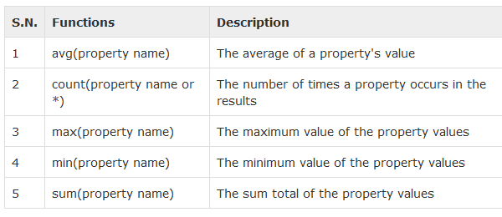
Aggregate Methods
HQL supports a range of aggregate methods, similar to SQL. They work the same way in HQL as in SQL and following is the list of the available functions:

Slide 61
THANK YOU

